Slide 1

by
B Jyothi

Slide 2
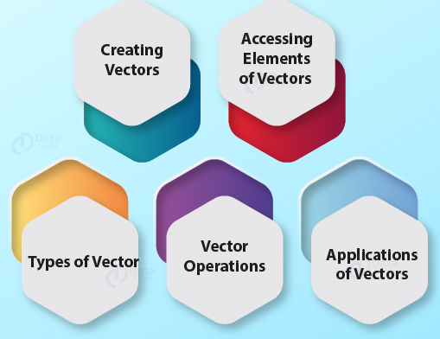

Slide 3
Vector:
A vector is a basic data structure
A sequence of elements which share the same data type is known as vector
The elements which are contained in vector known as components of the vector
A vector supports :
logical,
integer,
double,
character,
complex,
raw data type.

Slide 4
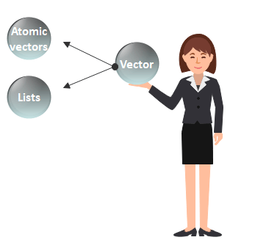
Vector is classified into two parts:

Slide 5
They have three common properties:
Type function – What it is?
typeof()
Length function – How many elements it contains.
length()
Attribute function – Extra arbitrary metadata.
attributes(), attr()

Slide 6
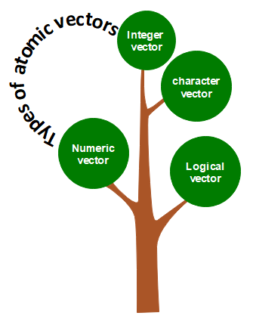
Atomic Vectors in R

Slide 7
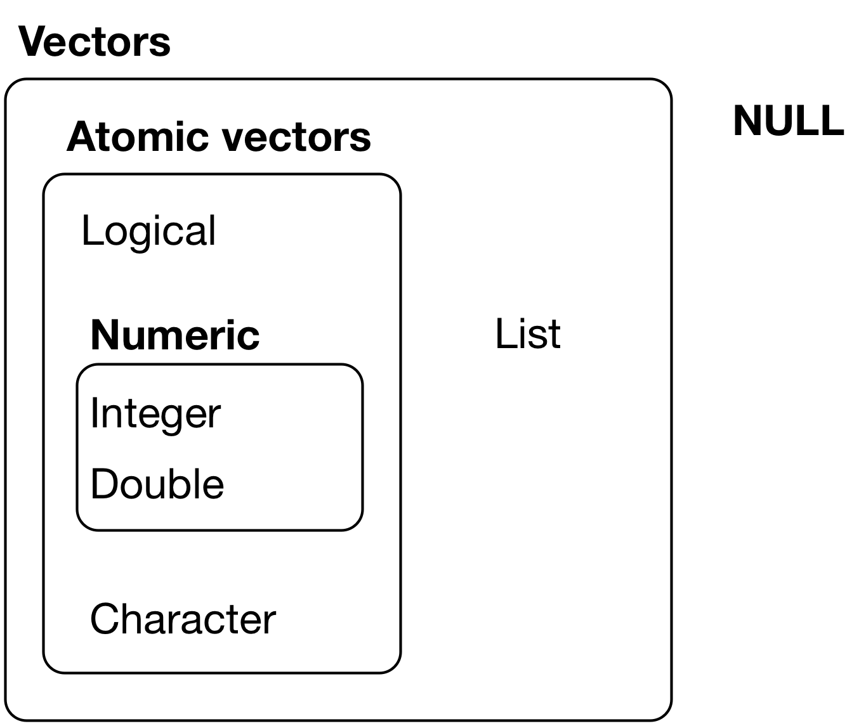
The hierarchy of R’s vector types

Slide 8
Numeric Vector
Decimal values are referred to as numeric data types in R
For example: =,<-
> x <- 53.5 #Assigning a decimal value to x
> x =53 #Printing the value of x
> print(x)
> Class(x) #Printing the class name of x
> typeof(x) # data type of x

Slide 9
Integer vector
A non-fraction numeric value is known as integer data.
A vector which contains integer elements is known as an integer vector.
use the as.integer() function:
d=5
Ex: > d <-as.integer (5) #Using as.integer()
L notation: appending of L to the value:
Ex: > e=5L
e <- 5L #Appending L to 5
> typeof (e) #Checking data-type of e

Slide 10
Character vector
There are two ways to create a character data type value in R:
as.character() function :
Ex:
f <-65
f <-as.character(f)
typeof(f)
double quotes "" or single quotes ''.
Ex:
d<-‘Anurag '
e<-“University "

Slide 11
Logical vector
The logical data types have only two values i.e., True or False.
Ex:
> a =3; b =6 #sample values
> g = a>b # is a larger than b?
> g #print the logical value

Slide 12
R provides many functions to examine features of vectors and other objects
for example
class() - what kind of object is it (high-level)
typeof() - what is the object’s data type (LL)?
length() - how long is it? What about two dimensional objects?
attributes() - does it have any metadata?

Slide 13
Converting Data Types in R
Conversion into Numeric : as.numerical ()
Conversion into Integer : as.integer()
Conversion into Complex: as.complex()
Conversion into Logical: as.logical ()
Conversion into character: as.character ()
We can convert a value of any data type into character data type using the as.character function.
The function converts the original value into a character string.

Slide 14
How to create a vector in R

Slide 15
Vector Creation
Single Element Vector:
Ex:
num_x=55.4 = ,<- , ->
int_y=9L
ch=“Hello” ch <- “hi” “hi”-> ch
com=6+5i
r=charToRaw(“hello”)

Slide 16
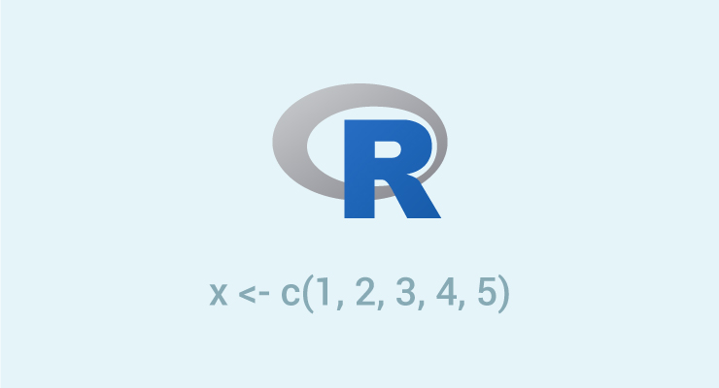
Vector Creation: c()
Multiple Elements Vector
There are several ways to creating a vector:
Vectors are generally created using the c() function.

Slide 17
Vector Creation- colon : operator
Using the colon(:) operator
If we want to create a vector of consecutive numbers, the : operator is very helpful.
z <-x:y
This operator creates a vector with elements from x to y and assigns it to z.
Ex:
> x <- 1:5
> print(x) Output: 1 2 3 4 5
> y=4: -10
>y
Output: [1] 4 3 2 1 0 -1 -2 -3 -4 -5 -6 -7 -8 -9 -10
v <- 3.8:11.4 o/p: 3.8 4.8 5.8 6.8 7.8 9.8 10.8

Slide 18
Vector creation : seq()
Setting step size with ‘by’ parameter:
Ex:
> seq(1, 3, by=1) # specify step size
output: [1] 1.0 1.2 1.4 1.6 1.8 2.0 2.2 2.4 2.6 2.8 3.0
‘length.out’ feature:
Ex:
> seq(1,4,length.out=0.6)
output: 1.0 1.6 2.2 2.8 3.4 4.0

Slide 19
1.Seq()
seq()– seq() function generates regular numeric sequences. The function has the following arguments:
from: starting value
to: ending value
by: increment (default is 1)
length.out: length of the sequence
along.with: the length of this argument can define the length of the sequence.

Slide 20
2.rep()
rep() – The rep() function repeats a given numeric vector. The function has the following arguments:
X: x is the numeric vector that is repeated.
times: number of repetitions.
each: number of repetitions for each element of the vector.
length.out: the length of the resultant vector. The function repeats until it reaches the length.
Code:
> vec_rep <- rep(c(2,3,4), times=3)
> vec_rep

Slide 21
3. sum()
sum() – The sum() function returns an integer value which is the sum of all the elements in a vector.
Code:
> sum(vec_rep)

Slide 22
What is coercion in R vector?
Vectors only hold elements of the same data type. If there is more than one data type, the c() function converts the elements. This is known as coercion.
The conversion takes place from lower to higher types.
logical < integer < double < complex < character.

Slide 23
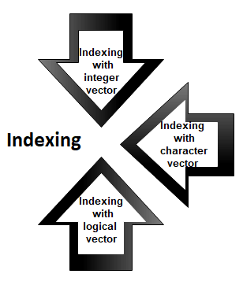
Accessing elements of vectors

Slide 24
Indexing with Integer Vector:
Indexing with Integer Vector
Ex:
> x=1:10
We can perform indexing by specifying integer value in square braces [ ]
> x[2] # access 2nd element O/P: [1] 2
>x[c(2,5)] # access 2nd and 5th element O/P: [1] 2 5
> x[-3] # access all but 3st element O/P: [1] 2 4 5 6 7 8 910
Note: cannot mix positive and negative integers

Slide 25
Indexing with Character Vector:
Ex:
> x <- c("One" = 1, "Two" = 2, "Three" = 3)
> x["Two"]

Slide 26
Indexing with Logic Vector:
Ex:
> a <- c(1,2,3,4)
> a[c(TRUE, FALSE, TRUE, FALSE)]

Slide 27
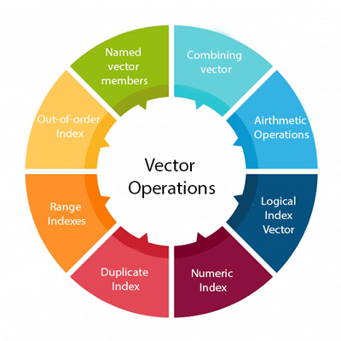
Vector Operation

Slide 28
Thank you

Slide 29
https://r4ds.had.co.nz/vectors.html
http://www.simonqueenborough.info/R/basic/lessons/Subsetting_Vectors.html#:~:text=The%20way%20you%20tell%20R,first%20ten%20elements%20of%20x.
https://datascienceplus.com/vectors-and-functions-in-r/
https://www.educba.com/vectors-in-r/
https://www.c-sharpcorner.com/article/operations-on-vector-in-r-with-example/
http://www.philender.com/courses/multivariate/notes/vecr.html

